Slide 1

MIRPUR UNIVERSITY OF SCIENCE AND TECHNOLOGY (MUST), MIRPUR DEPARMENT OF COMPUTER SCIENCE & INFORMATION TECHNOLOGY

Slide 2
RiskBeat (Heart Disease Prediction System) Group no: ?
Group Members:
Abdul Ahad (083)
Zafran Haider(064)
Ghanwa Rani(087)
Supervised by:
Ms Summiya Akram
(Lecturer)
Date: April 23, 2020

Slide 3

List of Contents
Introduction and Type of project
*Type of project means either website/mobile app/research based project
Objectives / Goals
Requirements
Project Design
Conceptual / Logical Design
ERD, USE CASES
Physical Design
Backend Design (Database)
Front End Design
Tools
Screen shorts of your system
Contributions (Achieved Objectives / Goals)
Demo

Slide 4
Introduction and Type of project
Heart Disease Risk Prediction System (Web Based Project)
What is it?
A machine learning-based system to predict heart disease risk levels (low, high).
Why design this system?
To enable early diagnosis and better treatment planning.
To reduce dependency on expensive and time-consuming tests.
To utilize healthcare data effectively for predictive analysis.
To assist healthcare providers with data-driven decision-making.
How will it be implemented?
Uses XG Boost Algorithm for prediction.
Evaluates performance using a confusion matrix to calculate accuracy, precision, and recall.
Modules include disease prediction, doctor search, feedback, and appointment management.

Slide 5
Objectives / Goals
Primary Objectives:
Early detection of heart disease risk based on medical parameters.
Provide affordable, efficient, and accessible diagnostic solutions.
Secondary Objectives:
Facilitate informed decision-making for doctors and patients.
Improve healthcare quality while reducing treatment costs.
Identify patterns and relationships between medical factors.
Outcome Goals:
Minimize life-threatening situations by timely diagnosis.
Offer personalized insights to patients for better health management.

Slide 6
Functional Requirements
User(Patient) Requirements
Register/login to the system.
Input medical parameters (age, blood pressure, cholesterol, etc.).
View heart disease risk prediction (low/high).
Access lifestyle assessment and fitness tracking.
Book doctor appointments (online/offline).
Interact with the chatbot (Risk Beat) for symptom analysis.
View disease information and preventive measures.
Participate in community discussions.
Doctor Requirements
View patient risk predictions.
Access patient medical history.
Provide consultations.
Update availability for appointments.
Give feedback on prediction accuracy.
Admin Requirements
Manage user roles (patients, doctors).
Appoint Doctors
Update information's and health checkup alerts.
Analyze feedback for system improvements.

Slide 7
Non Functional Requirements
Usability
Simple and intuitive user interface for all user roles.
Mobile-friendly design.
Performance
Fast response time for predictions and chatbot interaction.
Low latency in loading doctor profiles and tracking data.
Reliability
System must be available 24/7 with minimal downtime.
Accurate ML predictions and consistent chatbot responses.
Scalability
System should handle increased users and data volume without performance loss.
Security
Secure login for users, doctors, and admin.
Encrypt sensitive data such as health records and personal details.
Maintainability
Code should be modular and well-documented for future updates.
Easy to fix bugs and introduce new features.
Compatibility
Should work across modern web browsers and mobile devices.

Slide 8
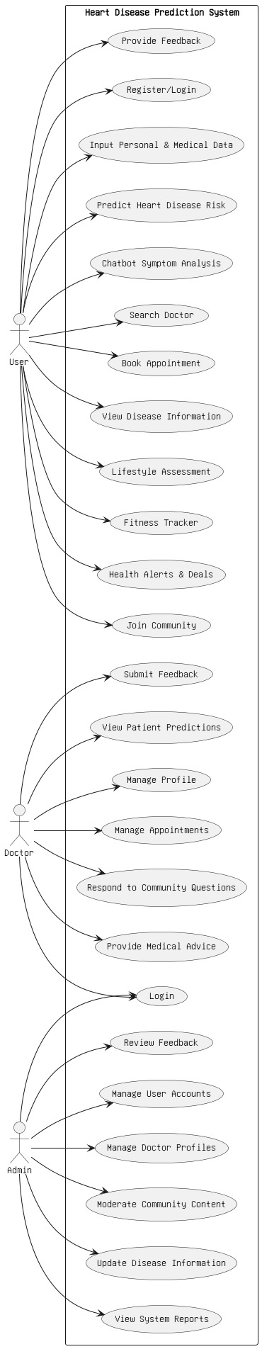
Project Design
Use Case Diagram:
Actors:
User
Doctor
Admin

Slide 9
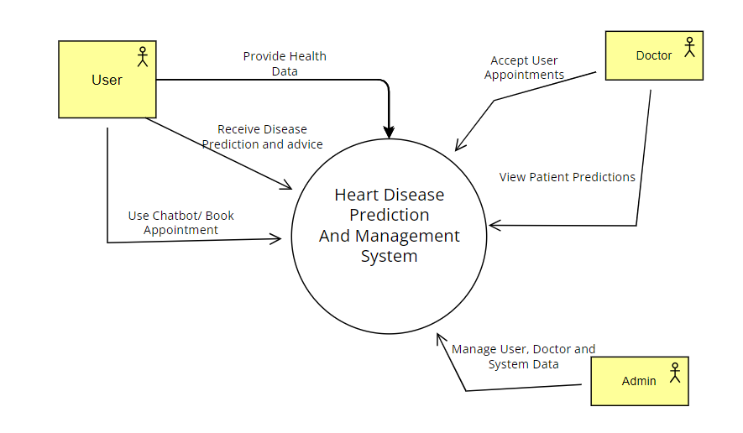
Project Design
Context Diagram:

Slide 10
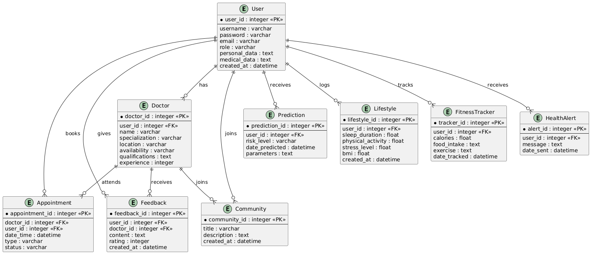
Project Design
ER Diagram:

Slide 11
Project Design
Main Conceptual Design
Entities & Relationships
User (from Django’s built-in model)
Patient → belongs to → User (1-to-1)
Doctor → belongs to → User (1-to-1)
Booking → belongs to → Doctor (M-to-1)
Feedback → belongs to → User (M-to-1)
Contact – standalone
Main Logical Design (Patient, Doctor)
Tables (simplified structure):
Patient
user_id (FK)
Contact, Address
values_list
created
Doctor
user (FK to User)
status (Active/Inactive)
contact
address
experience
category
doj
dob
image

Slide 12

Project Design
Normalization
✔️ All models follow 3NF rules.
✔️ User info is reused via Foreign Key.
✔️ No data duplication (DRY).
✔️ Easy to maintain and scale.
The Process From Unnormalized to 3NF
✅ 1NF
Break doctor data into a separate Doctor table.
✅ 2NF
Make sure each non-key field depends on full key. (e.g., "doctor_contact" only exists in Doctor table, not Booking)
✅ 3NF
Remove transitive dependencies. (e.g., don’t store "doctor_name" in Booking if already FK to Doctor → who has name)

Slide 13
Project Design
Tool | Purpose
Django ORM | Used to design and manage the database using Python code.
SQLite | Any RDBMS can be plugged into Django. Usually SQLite is default.
Admin Panel | Django's built-in admin is used to manage and view DB records.
Migrations | Django auto-generates migration files to sync Python models with the actual database.

Slide 14
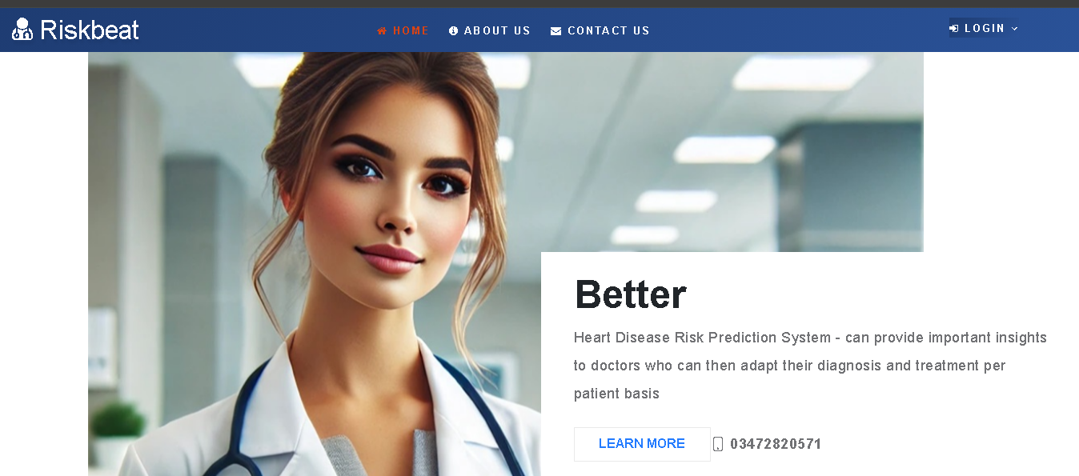
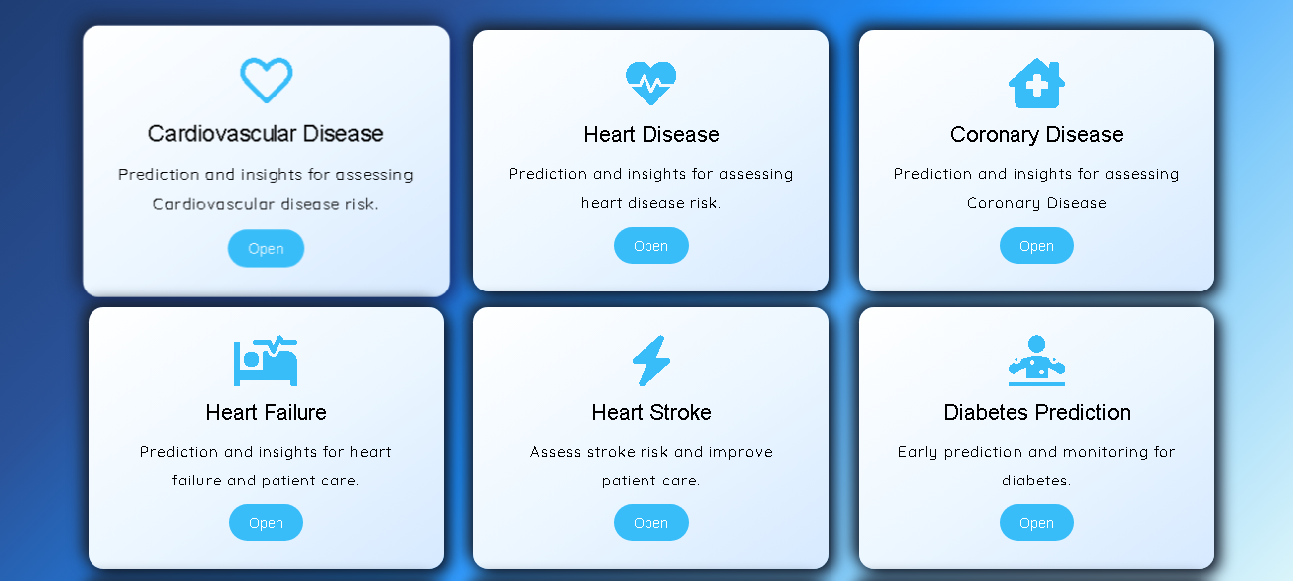
Project Design
All Tools
Backend : Python
Frontend : HTML, CSS, JavaScript
Frameworks: Django , Bootstrap
ML Algorithm: XG Boost
Database: SQLite
Screenshots

Slide 15
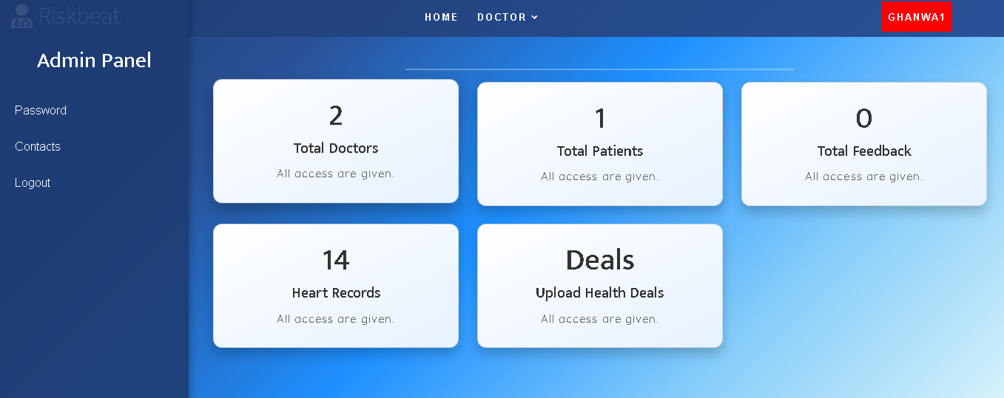
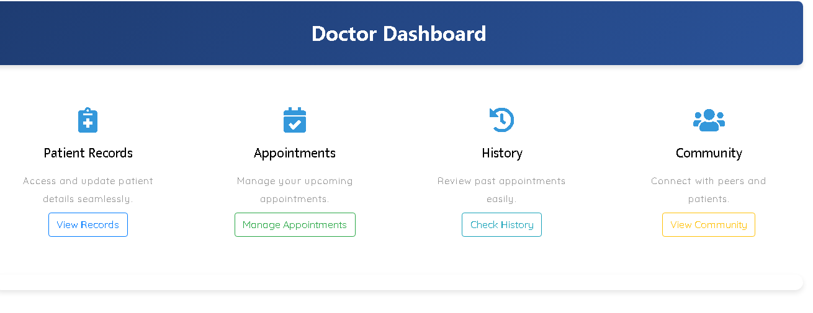
Project Design

Slide 16
Contributions
Achieved Objectives
The Heart Disease Risk Prediction System (RiskBeat) aimed to provide an intelligent, accessible, and cost-effective tool to predict heart disease risk using machine learning. The following objectives were successfully achieved in alignment with the original project goals:
Heart Disease Prediction: Successfully implemented 6 ML models to predict heart disease risk based on 13 key health parameters.
Interactive Chatbot (Risk Beat Diagnosis): A working chatbot was developed to guide users by analyzing symptoms and suggesting possible conditions.
Lifestyle & Fitness Modules: Integrated a Lifestyle Assessment and Fitness Tracker to monitor habits and calculate risk based on real-time inputs.
Doctor Appointment & Search Module: Users can find doctors based on specialization/location and book both physical and virtual appointments.
Role-Based Logins: Developed secure role-based access for Admins, Doctors, and Users.
Community & Feedback System: Added community interaction features and a feedback system to improve user engagement and system quality.

Slide 17
Contributions
Team Contributions
Syed Zafran Haider Kazmi: Led system development, machine learning integration, and prediction engine.
Muhammad Abdul Ahad: Developed backend module-Fitness Tracker, and completed full project documentation.
Ghanwa Rani: Handled frontend design improvements, some backend modules user interface testing, and overall system testing.

Slide 18
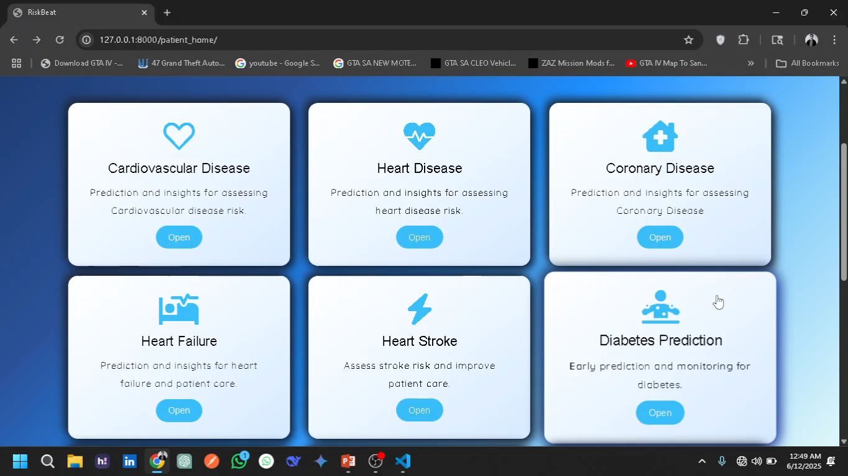
Riskbeat Demo
EMO!

